Slide 1
A Configurable High-Throughput Linear Sorter System
Jorge Ortiz Information and Telecommunication Technology Center 2335 Irving Hill Road Lawrence, KS jorgeo@ku.edu
David Andrews Computer Science and Computer Engineering The University of Arkansas 504 J.B. Hunt Building, Fayetteville, AR dandrews@uark.edu

Slide 2
Introduction

Slide 3
Introduction
Sorting an important system function Popular sorting algorithms not efficient or fast in hardware implementations
Linear sorters ideal for hardware, but sort at a rate of 1 value per cycle
Sorting networks better at throughput, but with high area and latency cost
Need a better solution for high throughput, low latency sorting

Slide 4
Contributions
Expanding the linear sorter implementation and making it versatile, reconfigurable and better suited for streaming input and output
Parallelizing the linear sorter for increased throughput
Implementing the high-throughput linear sorter, and outmatching the performance of current linear sorter approaches

Slide 5
Background

Slide 6
Background
Software quicksort, mergesort and heapsort use divide-and-conquer techniques to achieve efficiency
Hardware sorting plagued with overhead from data movements, synchronization, bookkeeping and memory accesses
Need better use of concurrent data comparisons and swaps, rather than the extended execution of multiple assembly instructions like its software counterpart

Slide 7
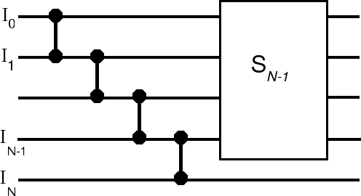
Sorting Networks
Swap comparators sort pairs of values
Sink lowest value, then operate on remaining S_{n-1} items
Receive parallel data at inputs
High #PE and latency, resort with each new insertion
Bubble Sort
3
3
2
2
5
5
4
4
1
1

Slide 8
Sorting Networks
Swap comparators sort pairs of values
Sink lowest value, then operate on remaining S_{n-1} items
Receive parallel data at inputs
High #PE and latency, resort with each new insertion
Bubble Sort
3
2
2
3
5
5
4
4
1
1

Slide 9
Sorting Networks
Swap comparators sort pairs of values
Sink lowest value, then operate on remaining S_{n-1} items
Receive parallel data at inputs
High #PE and latency, resort with each new insertion
Bubble Sort
3
2
2
3
5
4
4
5
1
1

Slide 10
Sorting Networks
Swap comparators sort pairs of values
Sink lowest value, then operate on remaining S_{n-1} items
Receive parallel data at inputs
High #PE and latency, resort with each new insertion
Bubble Sort
3
2
2
3
5
4
4
1
1
5

Slide 11
Sorting Networks
Swap comparators sort pairs of values
Sink lowest value, then operate on remaining S_{n-1} items
Receive parallel data at inputs
High #PE and latency, resort with each new insertion
Bubble Sort
3
2
2
3
5
1
4
4
1
5

Slide 12
Sorting Networks
Swap comparators sort pairs of values
Sink lowest value, then operate on remaining S_{n-1} items
Receive parallel data at inputs
High #PE and latency, resort with each new insertion
Bubble Sort
3
2
2
1
5
3
4
4
1
5

Slide 13
Sorting Networks
Swap comparators sort pairs of values
Sink lowest value, then operate on remaining S_{n-1} items
Receive parallel data at inputs
High #PE and latency, resort with each new insertion
Bubble Sort
3
1
2
2
5
3
4
4
1
5

Slide 14
Linear Sorters
Sorted insertions
Forwards incoming value to all nodes
Each node shifts autonomously depending on neighbors’ values
Single clock latency, small logic & regular structure
Streaming input & output
Serial input, need higher throughput
Input:
Output:
Notes:
Throughput: the rate at which data elements are processed

Slide 15
Linear Sorters
Sorted insertions
Forwards incoming value to all nodes
Each node shifts autonomously depending on neighbors’ values
Single clock latency, small logic & regular structure
Streaming input & output
Serial input, need higher throughput
Input:
3
Output:
Notes:
Throughput: the rate at which data elements are processed

Slide 16
Linear Sorters
Sorted insertions
Forwards incoming value to all nodes
Each node shifts autonomously depending on neighbors’ values
Single clock latency, small logic & regular structure
Streaming input & output
Serial input, need higher throughput
Input:
2
3
Output:
Notes:
Throughput: the rate at which data elements are processed

Slide 17
Linear Sorters
Sorted insertions
Forwards incoming value to all nodes
Each node shifts autonomously depending on neighbors’ values
Single clock latency, small logic & regular structure
Streaming input & output
Serial input, need higher throughput
Input:
5
2
3
Output:
Notes:
Throughput: the rate at which data elements are processed

Slide 18
Linear Sorters
Sorted insertions
Forwards incoming value to all nodes
Each node shifts autonomously depending on neighbors’ values
Single clock latency, small logic & regular structure
Streaming input & output
Serial input, need higher throughput
Input:
4
2
3
5
Output:
Notes:
Throughput: the rate at which data elements are processed

Slide 19
Linear Sorters
Sorted insertions
Forwards incoming value to all nodes
Each node shifts autonomously depending on neighbors’ values
Single clock latency, small logic & regular structure
Streaming input & output
Serial input, need higher throughput
Input:
1
2
3
4
5
Output:
Notes:
Throughput: the rate at which data elements are processed

Slide 20
Linear Sorters
Sorted insertions
Forwards incoming value to all nodes
Each node shifts autonomously depending on neighbors’ values
Single clock latency, small logic & regular structure
Streaming input & output
Serial input, need higher throughput
Input:
1
2
3
4
5
Output:
1
2
3
4
5
Notes:
Throughput: the rate at which data elements are processed

Slide 21
Configurable Linear Sorter

Slide 22
Configurable Linear Sorter
Increase versatility for linear sorters
Configurable:
Linear sorter depth
Sorting direction
Sort on tags (for example, timestamps) rather than data
User-defined data and tag size

Slide 23
Configurable Linear Sorter
Increase functionality for linear sorters
Detect full conditions
Buffer input while full
Retrieve output serially for streaming
Delete top value, freeing nodes
Augment with left shift functionality
Test tags before deleting them

Slide 24
Extended Linear Sorter System
Clock Cycles
Inserted Tags
Sorted Output
Node 1
Node 2
Node 3
Node 4
Node 5
Node 6
0
5

Slide 25
Extended Linear Sorter System
Clock Cycles
Inserted Tags
Sorted Output
Node 1
Node 2
Node 3
Node 4
Node 5
Node 6
0
5
1
7
5

Slide 26
Extended Linear Sorter System
Clock Cycles
Inserted Tags
Sorted Output
Node 1
Node 2
Node 3
Node 4
Node 5
Node 6
0
5
1
7
5
2
6
5
7

Slide 27
Extended Linear Sorter System
Clock Cycles
Inserted Tags
Sorted Output
Node 1
Node 2
Node 3
Node 4
Node 5
Node 6
0
5
1
7
5
2
6
5
7
3
2
5
6
7

Slide 28
Extended Linear Sorter System
Clock Cycles
Inserted Tags
Sorted Output
Node 1
Node 2
Node 3
Node 4
Node 5
Node 6
0
5
1
7
5
2
6
5
7
3
2
5
6
7
4
1
2
5
6
7

Slide 29
Extended Linear Sorter System
Clock Cycles
Inserted Tags
Sorted Output
Node 1
Node 2
Node 3
Node 4
Node 5
Node 6
0
5
1
7
5
2
6
5
7
3
2
5
6
7
4
1
2
5
6
7
5
9
1
2
5
6
7

Slide 30
Extended Linear Sorter System
Clock Cycles
Inserted Tags
Sorted Output
Node 1
Node 2
Node 3
Node 4
Node 5
Node 6
0
5
1
7
5
2
6
5
7
3
2
5
6
7
4
1
2
5
6
7
5
9
1
2
5
6
7
6
3
1
2
5
6
7
9

Slide 31
Extended Linear Sorter System
Clock Cycles
Inserted Tags
Sorted Output
Node 1
Node 2
Node 3
Node 4
Node 5
Node 6
0
5
1
7
5
2
6
5
7
3
2
5
6
7
4
1
2
5
6
7
5
9
1
2
5
6
7
6
3
1
2
5
6
7
9
7
8
2
3
5
6
7
9

Slide 32
Extended Linear Sorter System
Clock Cycles
Inserted Tags
Sorted Output
Node 1
Node 2
Node 3
Node 4
Node 5
Node 6
0
5
1
7
5
2
6
5
7
3
2
5
6
7
4
1
2
5
6
7
5
9
1
2
5
6
7
6
3
1
2
5
6
7
9
7
8
2
3
5
6
7
9
8
4
3
5
6
7
8
9

Slide 33
Interleaved Linear Sorter System
Clock Cycles
Inserted Tags
Sorted Output
Node 1
Node 2
Node 3
Node 4
Node 5
Node 6
0
5
1
7
5
2
6
5
7
3
2
5
6
7
4
1
2
5
6
7
5
9
1
2
5
6
7
6
3
1
2
5
6
7
9
7
8
2
3
5
6
7
9
8
4
3
5
6
7
8
9
9
4
5
6
7
8
9

Slide 34
Interleaved Linear Sorter System
Clock Cycles
Inserted Tags
Sorted Output
Node 1
Node 2
Node 3
Node 4
Node 5
Node 6
0
5
1
7
5
2
6
5
7
3
2
5
6
7
4
1
2
5
6
7
5
9
1
2
5
6
7
6
3
1
2
5
6
7
9
7
8
2
3
5
6
7
9
8
4
3
5
6
7
8
9
9
4
5
6
7
8
9
10
4
5
6
7
8
9

Slide 35
Interleaved Linear Sorter System
Clock Cycles
Inserted Tags
Sorted Output
Node 1
Node 2
Node 3
Node 4
Node 5
Node 6
0
5
1
7
5
2
6
5
7
3
2
5
6
7
4
1
2
5
6
7
5
9
1
2
5
6
7
6
3
1
2
5
6
7
9
7
8
2
3
5
6
7
9
8
4
3
5
6
7
8
9
9
4
5
6
7
8
9
10
4
5
6
7
8
9
11
5
6
7
8
9

Slide 36
Extended Linear Sorter System
Clock Cycles
Inserted Tags
Sorted Output
Node 1
Node 2
Node 3
Node 4
Node 5
Node 6
0
5
1
7
5
2
6
5
7
3
2
5
6
7
4
1
2
5
6
7
5
9
1
2
5
6
7
6
3
1
2
5
6
7
9
7
8
2
3
5
6
7
9
8
4
3
5
6
7
8
9
9
4
5
6
7
8
9
10
4
5
6
7
8
9
11
5
6
7
8
9
12
6
7
8
9

Slide 37
Extended Linear Sorter System
Clock Cycles
Inserted Tags
Sorted Output
Node 1
Node 2
Node 3
Node 4
Node 5
Node 6
0
5
1
7
5
2
6
5
7
3
2
5
6
7
4
1
2
5
6
7
5
9
1
2
5
6
7
6
3
1
2
5
6
7
9
7
8
2
3
5
6
7
9
8
4
3
5
6
7
8
9
9
4
5
6
7
8
9
10
4
5
6
7
8
9
11
5
6
7
8
9
12
6
7
8
9
13
7
8
9

Slide 38
Extended Linear Sorter System
Clock Cycles
Inserted Tags
Sorted Output
Node 1
Node 2
Node 3
Node 4
Node 5
Node 6
0
5
1
7
5
2
6
5
7
3
2
5
6
7
4
1
2
5
6
7
5
9
1
2
5
6
7
6
3
1
2
5
6
7
9
7
8
2
3
5
6
7
9
8
4
3
5
6
7
8
9
9
4
5
6
7
8
9
10
4
5
6
7
8
9
11
5
6
7
8
9
12
6
7
8
9
13
7
8
9
14
8
9

Slide 39
Extended Linear Sorter System
Clock Cycles
Inserted Tags
Sorted Output
Node 1
Node 2
Node 3
Node 4
Node 5
Node 6
0
5
1
7
5
2
6
5
7
3
2
5
6
7
4
1
2
5
6
7
5
9
1
2
5
6
7
6
3
1
2
5
6
7
9
7
8
2
3
5
6
7
9
8
4
3
5
6
7
8
9
9
4
5
6
7
8
9
10
4
5
6
7
8
9
11
5
6
7
8
9
12
6
7
8
9
13
7
8
9
14
8
9
15
9

Slide 40
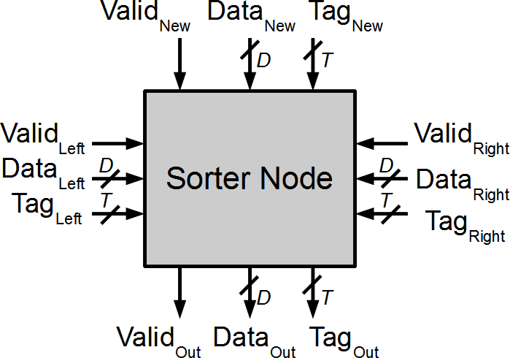
Sorter Node Architecture

Slide 41
Interleaved Linear Sorter

Slide 42
Interleaved Linear Sorter
Increase throughput by using multiple linear sorters with parallel inputs
Interleave parallel inputs into linear sorters through modulo arithmetic
Distribute data evenly among linear sorters to avoid full conditions
Service each linear sorter in round-robin fashion to resort their outputs

Slide 43
Interleaved Linear Sorter
ILS width = 4
Four parallel inputs
{13, 04, 03, 10}
After interleaving mod 4
{04, 13, 10, 03}
[00, 01, 02, 03]
But, what happens for inputs
{07, 05, 01, 06} ?

Slide 44
Interleaved Linear Sorter
Clock Cycles
Inserted Tags
LS 0
LS 1
LS 2
LS 3
0
13
4
3
10

Slide 45
Interleaved Linear Sorter
Clock Cycles
Inserted Tags
LS 0
LS 1
LS 2
LS 3
0
13
4
3
10
4
13
10
3
1
7
5
1
6
Inserted

Slide 46
Interleaved Linear Sorter
Clock Cycles
Inserted Tags
LS 0
LS 1
LS 2
LS 3
0
13
4
3
10
4
5
6
3
1
7
5
1
6
13
10
7
2
1
Preempted
Inserted

Slide 47
Interleaved Linear Sorter
Clock Cycles
Inserted Tags
LS 0
LS 1
LS 2
LS 3
0
13
4
3
10
4
1
6
3
1
7
5
1
6
5
10
7
2
1
13
3
2
9
12
15
Preempted
Inserted

Slide 48
Interleaved Linear Sorter
Clock Cycles
Inserted Tags
LS 0
LS 1
LS 2
LS 3
0
13
4
3
10
4
1
2
3
1
7
5
1
6
12
5
6
7
2
1
9
10
15
3
2
9
12
15
13
4
11
0
14
8
Preempted
Inserted

Slide 49
Interleaved Linear Sorter
Clock Cycles
Inserted Tags
LS 0
LS 1
LS 2
LS 3
0
13
4
3
10
0
1
2
3
1
7
5
1
6
4
5
6
7
2
1
12
9
10
11
3
2
9
12
15
13
14
15
4
11
0
14
8
5
8
Preempted
Inserted

Slide 50
Interleaved Linear Sorter
Clock Cycles
Inserted Tags
LS 0
LS 1
LS 2
LS 3
0
13
4
3
10
0
1
2
3
1
7
5
1
6
4
5
6
7
2
1
8
9
10
11
3
2
9
12
15
12
13
14
15
4
11
0
14
8
5
8
6
Preempted
Inserted

Slide 51
Interleaved Linear Sorter
Clock Cycles
Inserted Tags
LS 0
LS 1
LS 2
LS 3
0
13
4
3
10
0
1
2
3
1
7
5
1
6
4
5
6
7
2
1
8
9
10
11
3
2
9
12
15
12
13
14
15
4
11
0
14
8
5
8
6
Preempted
Inserted

Slide 52
Input Distribution and Latency
Assume uniformly distributed data
With W = 2, 50% chance of interleaving delays, adding an extra clock cycle
With W > 2, more probabilities of stalling, adding 1+ clock cycles
Average latency for Interleaved Linear Sorters of length W
ILS Width W | Clock Cycles
1 | 1.000
2 | 1.500
4 | 2.125
8 | 2.597
16 | 3.078
Larger ILS widths allow parallel sorting and increase throughput. However, they have complex routing and additional delays

Slide 53
Output Logic
Accumulate values before output becomes relevant
Increase linear sorter depth to accumulate more data
Re-sort top values from each linear sorter to ensure continuity (particularly for contiguous values)
Service in round-robin fashion: Test the top tag of each linear sorter before deleting

Slide 54
Streaming output
LS 0
LS 1
LS 2
LS 3
0
1
2
3
OK
4
5
6
7
OK
8
9
14
11
Output {8,9}; Wait for 10
13
15

Slide 55
Hardware Implementation

Slide 56
FPGA Area
Xilinx Virtex-5 FPGA
8-bit tags, 8-bit data
17 slices per sorter node
Linear Sorter depth of 16
Interleaved Linear Sorter FPGA Area
Linear Sorters, W | Total Slices | Slices/Node | Area Overhead | Interleaving Area (slices)
1 | 278 | 17.4 | 2.3% | 7
2 | 641 | 20.0 | 17.6% | 113
4 | 1294 | 20.2 | 18.8% | 243
8 | 2612 | 20.4 | 20.0% | 522
16 | 5250 | 20.5 | 20.6% | 1081

Slide 57
FPGA Throughput
f_{clk} x ILS width W
Includes logic and routing delay for interleaving data for W linear sorters
Averaged for sorter depth from 1 up to 256 nodes
Interleaved Linear Sorter FPGA Frequency & Throughput
Linear Sorters, W | Frequency (MHz) | Throughput (millions/sec)
1 | 299 | 299
2 | 275 | 550
4 | 275 | 1101
8 | 132 | 1058
16 | 40 | 645

Slide 58
FPGA Throughput
W=16, large logic & routing delays at inputs
First three cases need single 6-input LUT for routing. Two and four LUTs needed for W=8 and W=16, respectively.
Interleaved Linear Sorter FPGA Frequency & Throughput
Linear Sorters, W | Frequency (MHz) | Throughput (millions/sec)
1 | 299 | 299
2 | 275 | 550
4 | 275 | 1101
8 | 132 | 1058
16 | 40 | 645

Slide 59
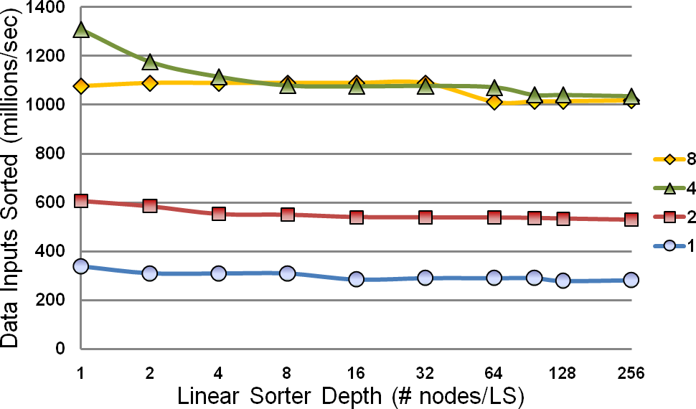
Maximum ILS Throughput
Average speedups of 1.0, 1.8, 3.7 and 3.5 against single linear sorter

Slide 60
Throughput considerations
Interleaving contention results in an average latency which increases with ILS width W
Average latency for Interleaved Linear Sorters of length W
ILS Width W | Clock Cycles
1 | 1.000
2 | 1.500
4 | 2.125
8 | 2.597
16 | 3.078

Slide 61
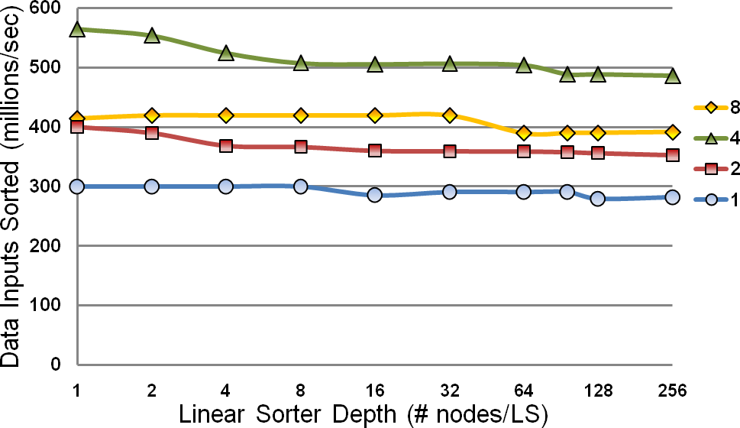
Normalized ILS Throughput
Average speedups of 1.0, 1.3, 1.8 and 1.4 against single linear sorter

Slide 62
Virtex II-Pro implementation
100 MHz bus frequency
Data resided on BlockRAMs
Tested Interleaved Linear Sorter W=4
Compared against MicroBlaze running quicksort in C
Timing includes bus arbitration, read
and writes over the OPB
Final result is saved in BlockRAM

Slide 63
Three test scenarios
MicroBlaze BRAM write & read-back
MB writes BRAM unsorted data
MB sends start signal to ILS
MB reads back sorted values over OPB
MicroBlaze BRAM write
Same as scenario 1
No need for read back into MB
No MicroBlaze
Hardware-only streaming output approach
No need for OPB requests
Output consumed by other hardware components immediately

Slide 64
ILS speedup over MicroBlaze
System | Clock cycles | Speedup
MicroBlaze quicksort | 49,982 | 1
ILS 1 – MB write & read | 2272 | 22
ILS 2 – MB write | 732 | 68
ILS 3 – Hardware-only | 30 | 1666
32-bit data
16-bit tags
64 values
ILS width of 4

Slide 65
ILS speedup against Sorting Network
System | Execution time (ns) | Speedup
Batcher odd-even | 95 | 1.0
ILS – Hardware only | 123 | 0.8
16-bit data-tags
32 values
ILS width of 4
Sorting network requires static data set
Re-sorts the full set of data upon a single new insertion

Slide 66
Conclusions

Slide 67
Conclusions
Linear sorters appropriate to overcome sorting network disadvantages, but limited throughput
Interleaved Linear Sorters allow high throughput, configuration of width, depth, tag and data size to match system requirements
ILS speedup of 1.8 over regular linear sorter (3.7 for best case)
ILS speedup of 68 against embedded software counterpart (1666 for best case)

Slide 68
Questions

